Slide 1

Project 1

Slide 2
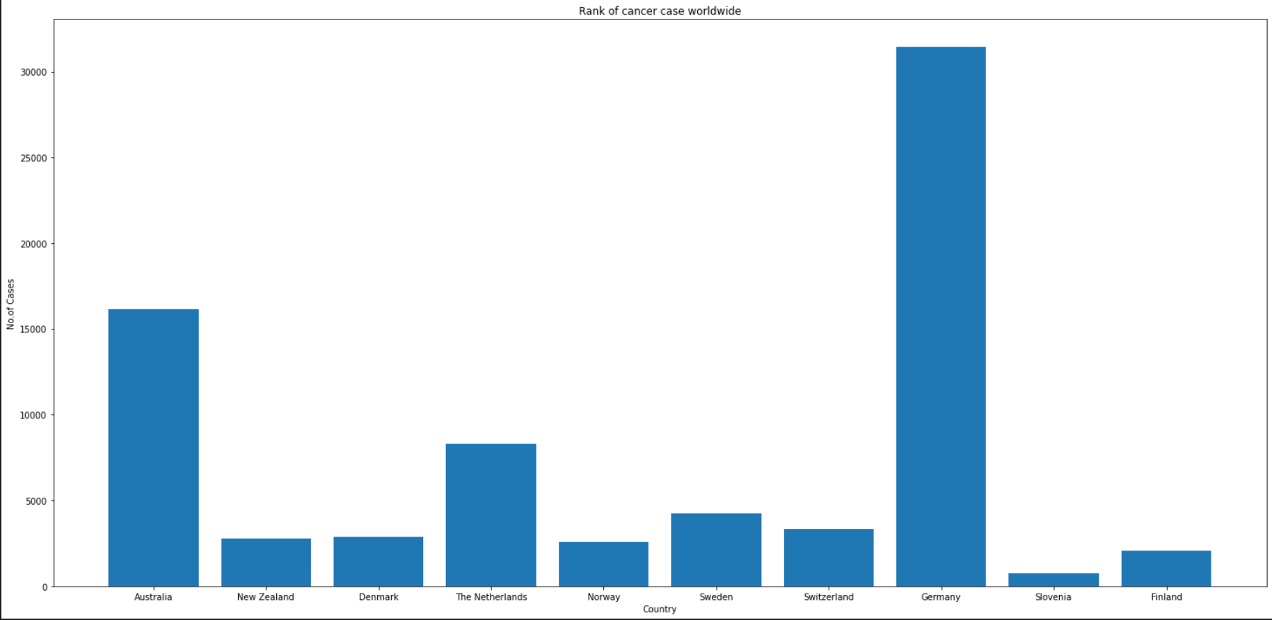
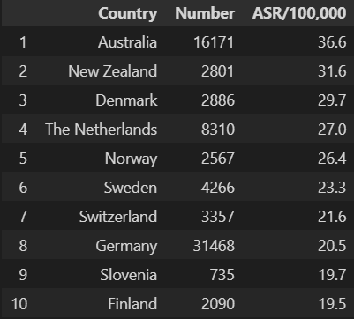
Australia vs Worldwide

Slide 3
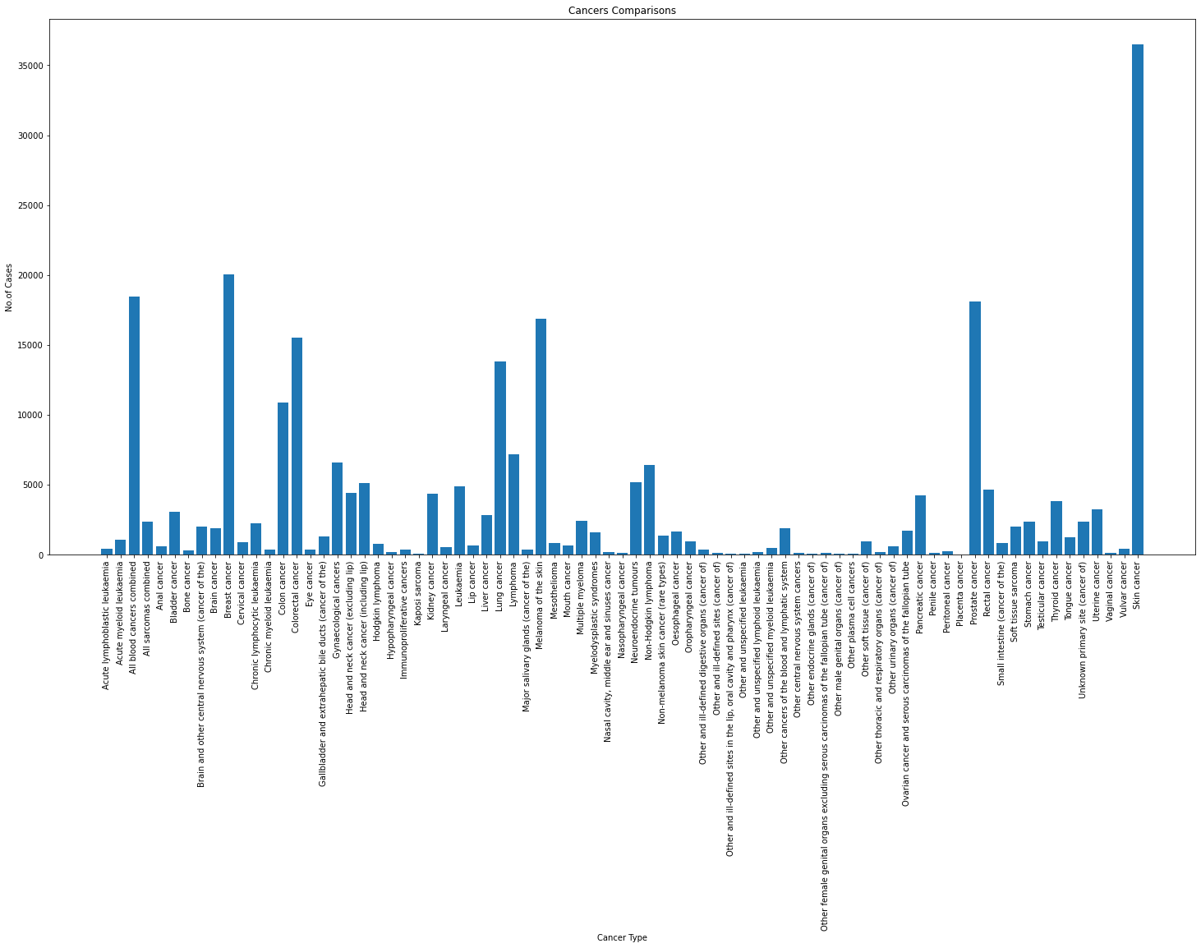
Different types of cancer in Australia

Slide 4
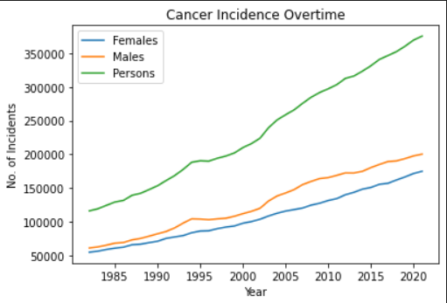
Cancer Incidence overtime

Slide 5
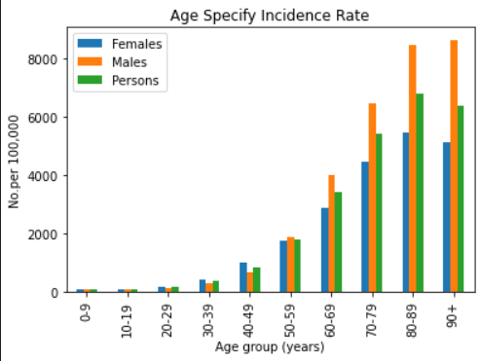
ASR Incidence vs Age group

Slide 6
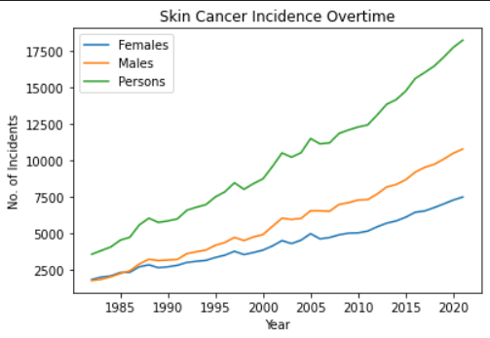
Skin Cancer Incidence overtime

Slide 7
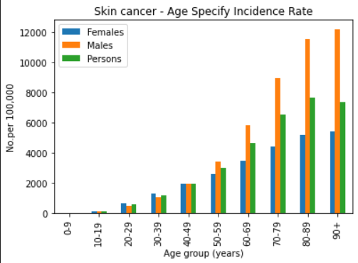

Slide 8

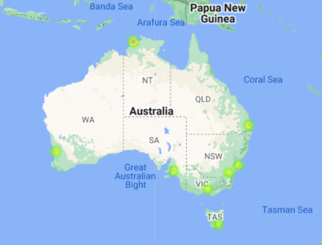
Australia major city avg.UV index

